Slide 1

Vitaline Food Private Limited
Our Goal is Improved Health

Slide 2
About
Vitaline is a venture of Tulsi Agro for producing all kinds of Premix for the Fortification of Foods. A Modern State of Art Production facility of Vitaline is situated at Rajkot, Industrial Area. Tulsi Agro is one of the renowned brands of Food Production and Agricultural Machineries. Tulsi agro is supplying machineries to Amul, Gujrat Government, Uttar Pradesh Government/SRLM and United Nations World Food Programme.

Slide 3
Company Address –
Manufacturing Unit: -
VITALINE NUTRI FOODS PRIVATE LIMITED
SUNLIGHT IND AREA, RIBDA, GONDAL
Rajkot, Gujarat, India, 360311.
Noida Office Address –
Rajkot Office Address-

Slide 4
Our Aim
Vitaline aims to fulfil the requirements of today's nutritional needs. As we know the world is facing a great challenge and burden of Micronutrient Malnutrition. We aim to deliver value-added ingredients/Micronutrient Premix to the food, Rice, Wheat, and nutrition industry.

Slide 5

Our Values
Humanity
Honesty
Hygiene and Safety

Slide 6
Our Work
Due to different challenges like eating habits, Economical crises, Poverty, War, and Climate Change. People are not getting the optimum micronutrients through their food. To tackle these challenges government is promoting Food Fortification in different Staple Foods, Milk, and Edible Oil. As well as giving supplementary food (THR) by adding micronutrients to the targeted population through ICDS. Vitaline is providing all kinds of Premix for fortification purposes like Wheat, Rice (Fortified Rice Kernel).

Slide 7
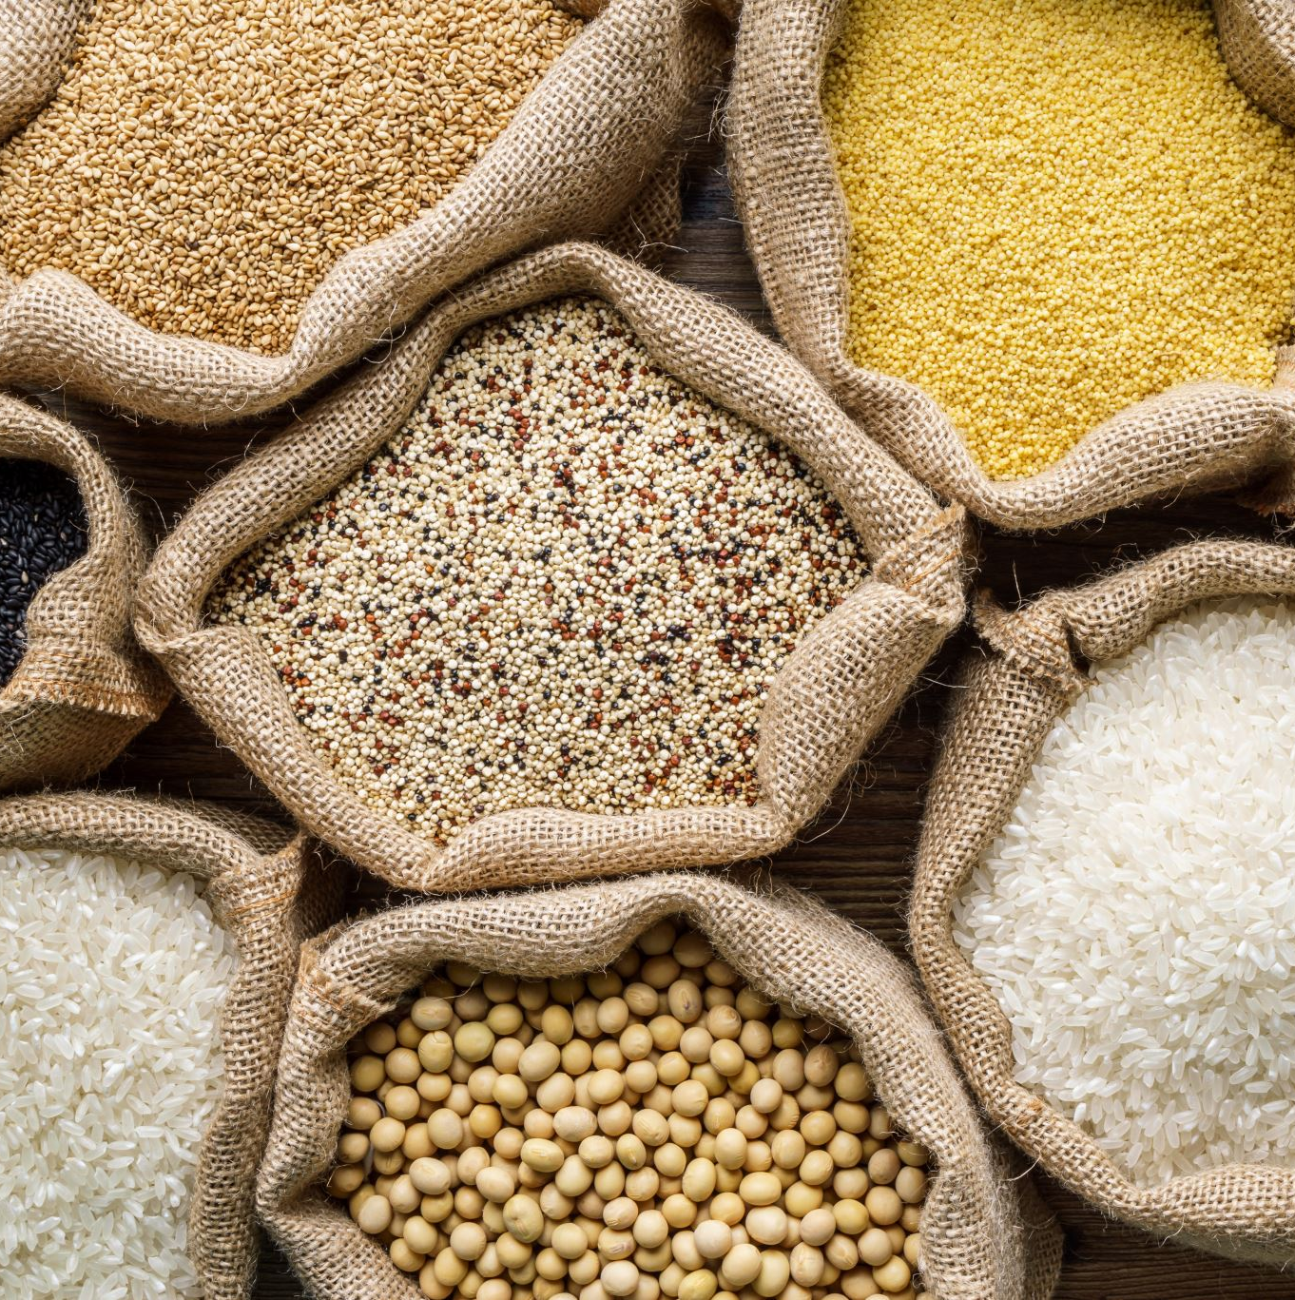
Our Products are – Micronutrient/Premix
Micronutrient Premix
FRK Rice Premix (Fortified Rice Kernel)
Wheat Flour/Atta Premix
THR Premix
Maida Premix
Custom Premixes for Nutritional Purpose
Food Fortification Premixes
All other kinds of Staple Food Fortification Premix

Slide 8
Thanks

